Slide 1
Introduction to protein-protein interactions (PPIs)
November 28th 2022
Grégory FETTWEIS, PhD

Slide 2
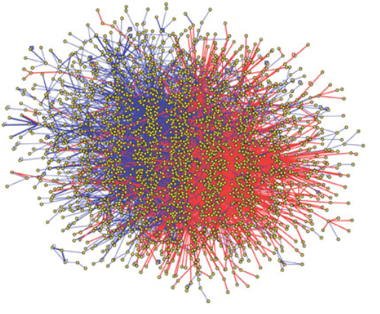
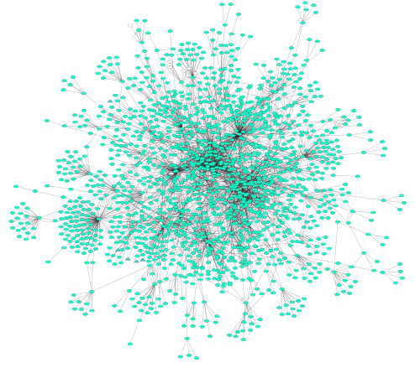
Some definitions…
Protein-protein interactions (PPIs): physical and selective contacts that happen between pairs of proteins, in certain molecular regions and in a defined biological context.
Interactome: the totality of PPIs that happen in a cell / in an organism / in a specific biological context...
Protein-protein interaction network: Graphical representation of a group of PPIs in which proteins are represented as nodes and interactions as edges.

Slide 3
But how does it really look like ?
Scheme
Reality

Slide 4
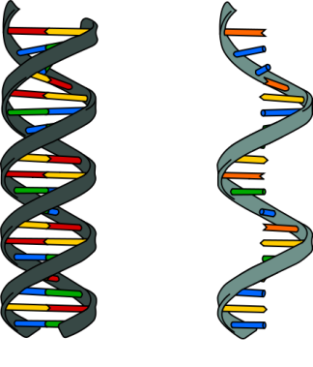
Why protein-protein interactions?
Gene level
Protein level
DNA
RNA
1 protein
=
1 function
WRONG!

Slide 5
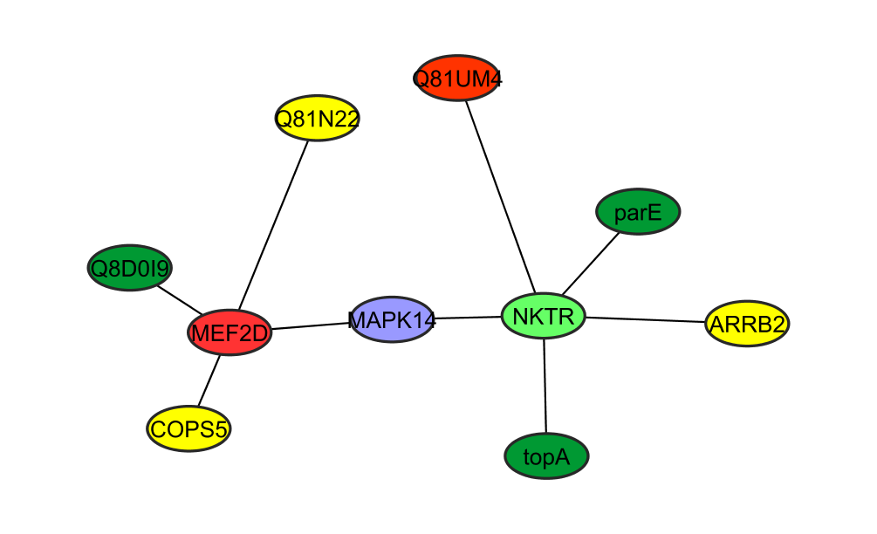
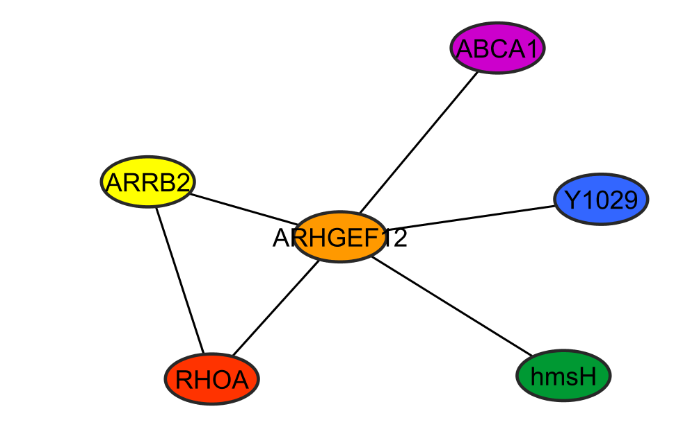
Why protein-protein interactions?
Gene level
Protein level
DNA
RNA
1 polypeptide
=
n functions
=
n networks!
1 protein
=
1 function

Slide 6
Why studying protein-protein interactions?
Gene level
Protein level
DNA
RNA
1 polypeptide
=
n functions
=
n networks!
1 protein
=
1 function
To predict a protein biological function
“guilt by association”
proteins with similar functions should cluster together
To improve characterization of protein complexes and pathways
interaction networks work as a draft map that brings detail to biological processes and pathways

Slide 7
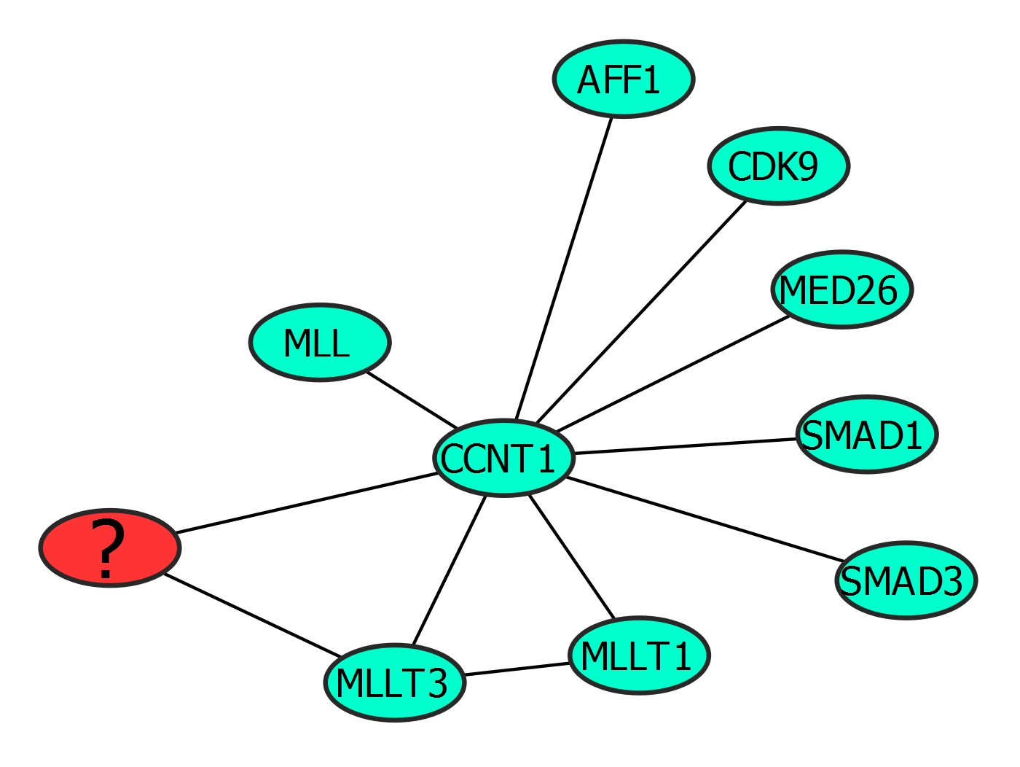
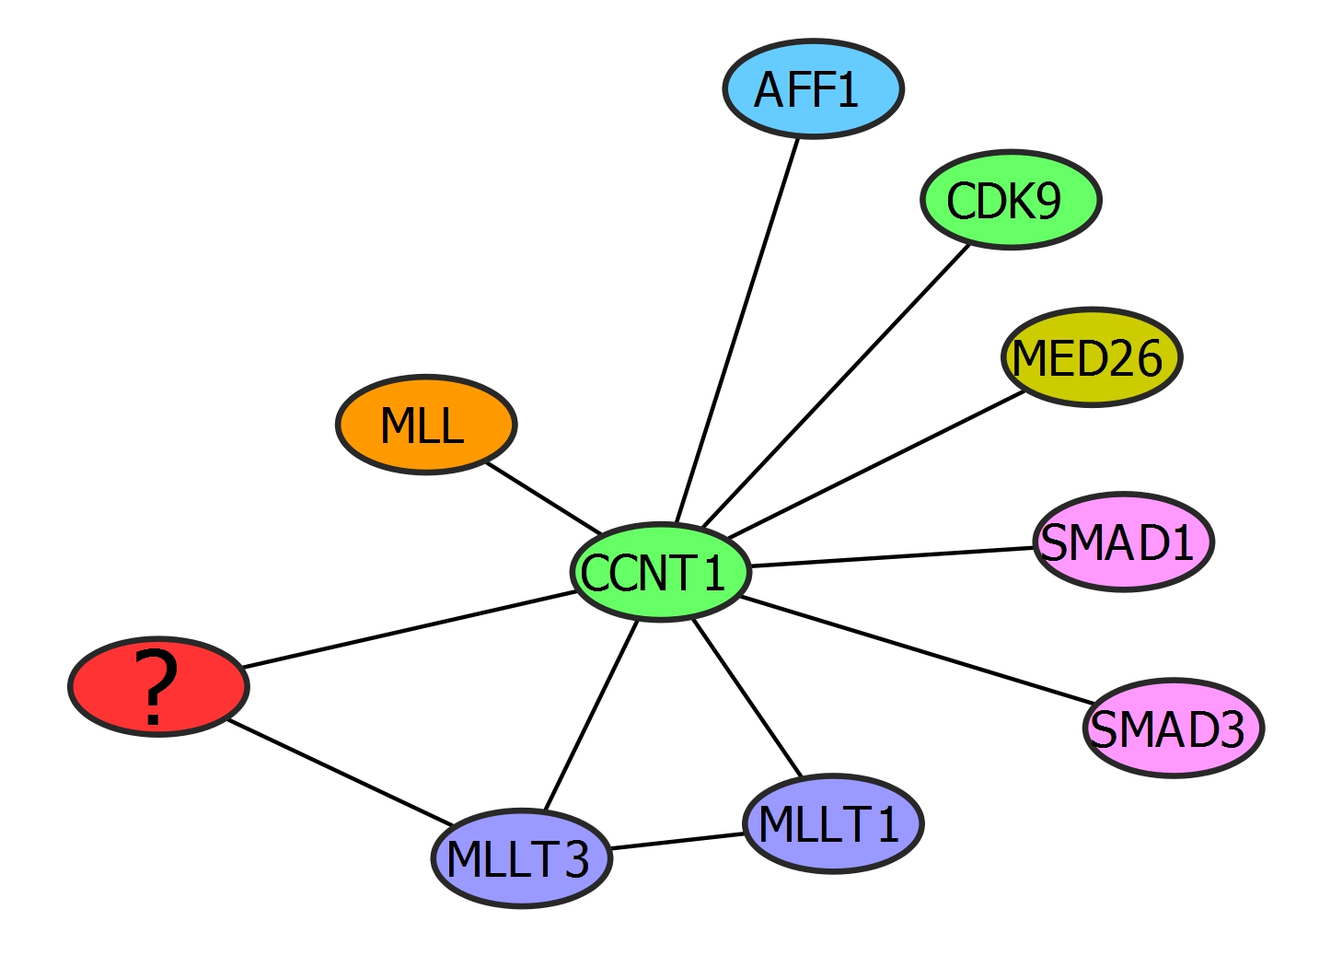
Guilt by association
Cyclin-dependent kinase
Role in transcription regulation
Proto-oncogene
Transcription factor
Mediator of RNA polymerase transcription activity
Role in transcription regulation
Histone methyltransferase
Role in early development and hematopoiesis
Cyclin
Regulation of cyclin kinase, transcription regulation and cell cycle control
Transcriptional modulator
Transcription regulation dependent on kinases
Something to do with transcription and cell cycle control
Receptor-activated transcription modulator
Transcription modulation, signal transduction, activated by kinases.
Role in inhibition of wound healing
Putative oncoprotein
Involved in transcription regulation
Putative oncoprotein
Transcription activation

Slide 8
Properties of PPIs
PPIs are physical contacts not necessarily functional contacts (ex : transcription complex)

Slide 9
Properties of PPIs
PPIs are physical contacts not necessarily functional contacts (ex : transcription complex)
PPIs are contacts between proteins only (not protein-DNA, protein-RNA etc..)

Slide 10
Properties of PPIs
PPIs are physical contacts not necessarily functional contacts (ex : transcription complex)
PPIs are contacts between proteins only (not protein-DNA, protein-RNA etc..)
PPIs are specific and occur for a reason (not accidental)

Slide 11
Properties of PPIs
PPIs are physical contacts not necessarily functional contacts (ex : transcription complex)
PPIs are contacts between proteins only (not protein-DNA, protein-RNA etc..)
PPIs are specific and occur for a reason (not accidental)
Interaction surfaces should be non-generic (evolved for a purpose)

Slide 12
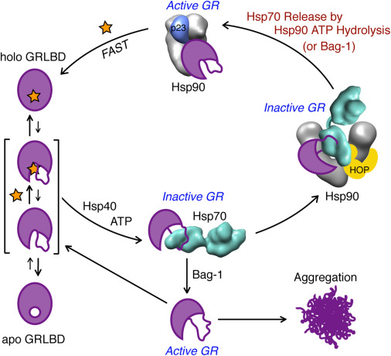
Properties of PPIs
PPIs are physical contacts not necessarily functional contacts (ex : transcription complex)
PPIs are contacts between proteins only (not protein-DNA, protein-RNA etc..)
PPIs are specific and occur for a reason (not accidental)
Interaction surfaces should be non-generic (evolved for a purpose)
PPIs are not necessarily static but can also be transient (TF and transcription machinery)

Slide 13
Properties of PPIs
PPIs are physical contacts not necessarily functional contacts (ex : transcription complex)
PPIs are contacts between proteins only (not protein-DNA, protein-RNA etc..)
PPIs are specific and occur for a reason (not accidental)
Interaction surfaces should be non-generic (evolved for a purpose)
PPIs are not necessarily static but can also be transient (TF and transcription machinery)
PPIs occur in specific biological context: not all possible interactions occur in all cells

Slide 14
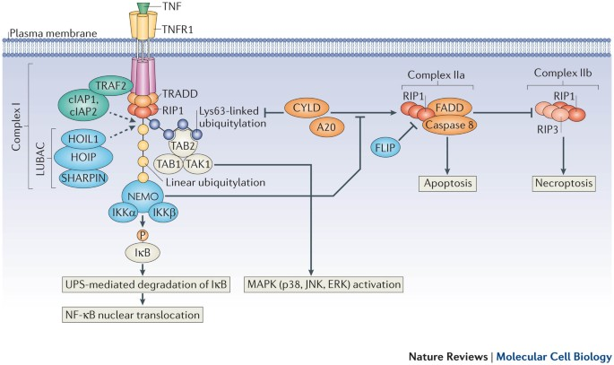
An example

Slide 15
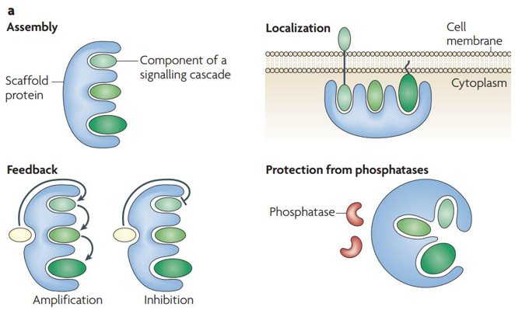
The case of Scaffold proteins
Definition: A protein whose main function is to bring other proteins together for them to interact.

Slide 16
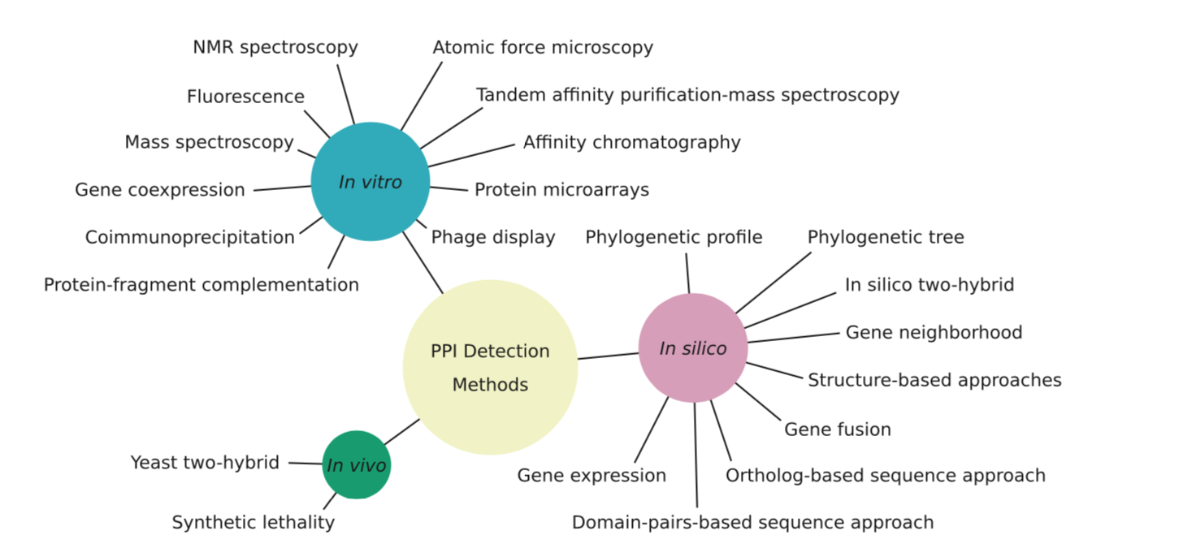
The arsenal of Protein-protein detection methods

Slide 17
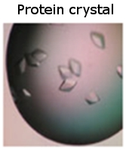
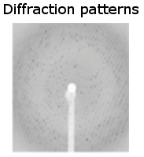
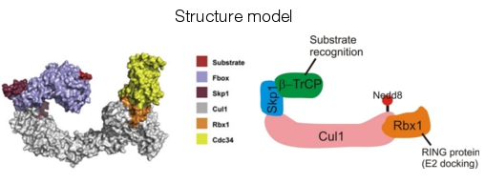
“Classical” Protein-protein interaction detection methods
X-ray diffraction studies
Low-throughput

Slide 18
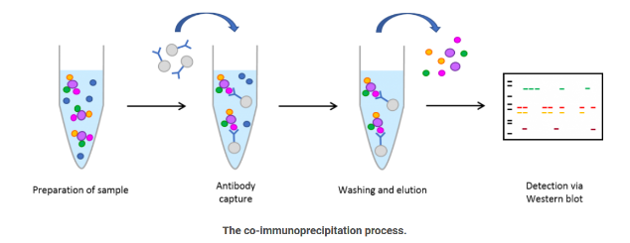
Low throughput classic method: Co-Immuno-Precipitation

Slide 19
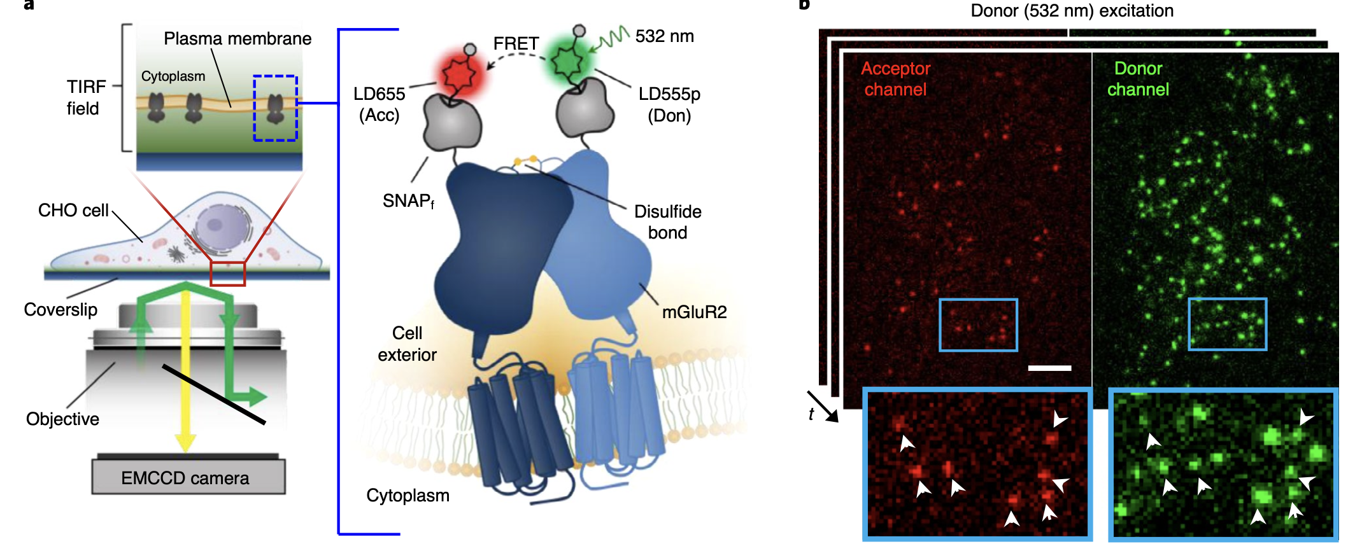
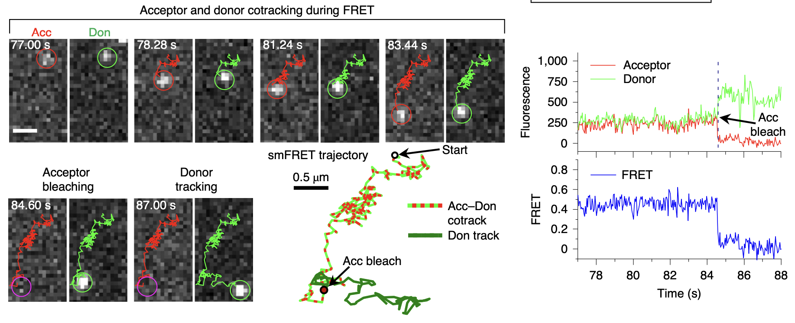
Advances in live Protein-protein interactions (smFRET)

Slide 20
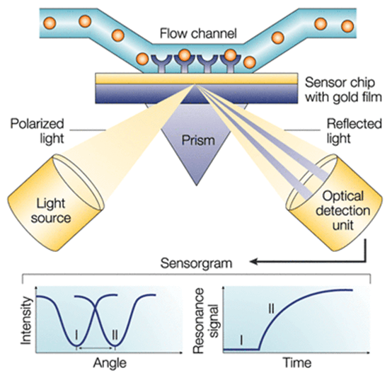
“Modern” Protein-protein interaction detection methods
Surface Plasmon Resonance
RU
C2 WT
45
40
35
30
25
KD (µM)
19.4 ± 1.2
20
15
10
5
0
-5
0
10
20
30
40
50
60
70
µM
RU
C2 Mutant
1
0
-1
-2
-3
0
10
20
30
40
50
60
70
80
µM
Affinity measurement !

Slide 21
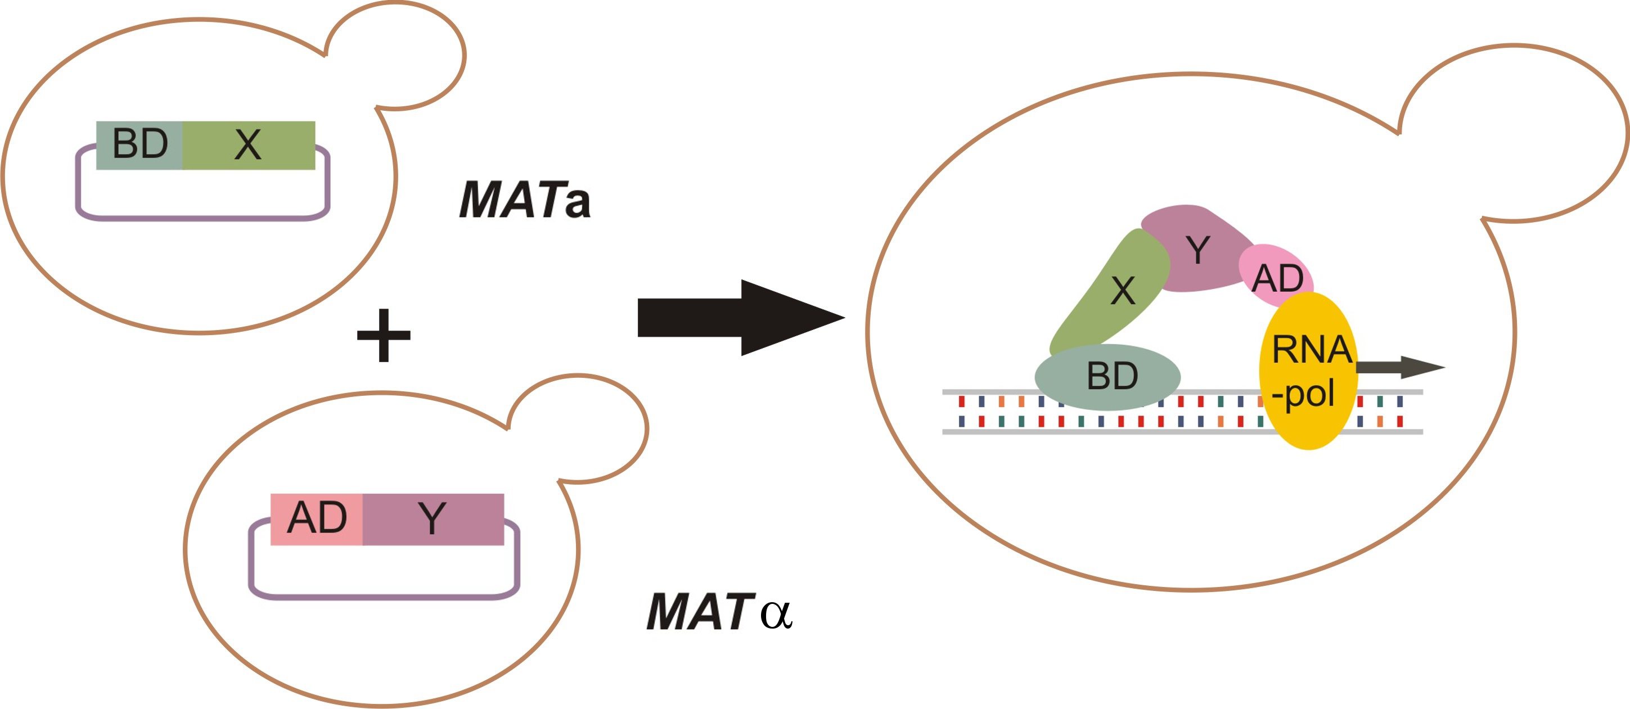
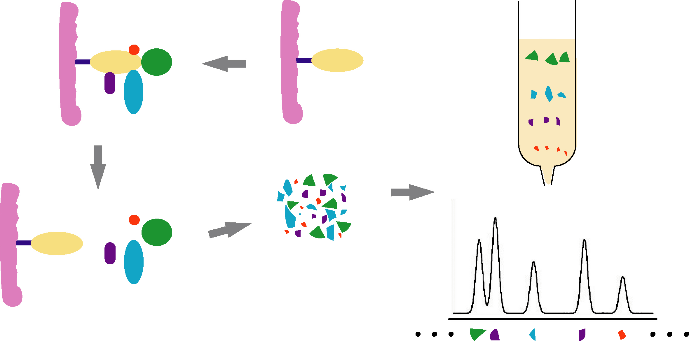
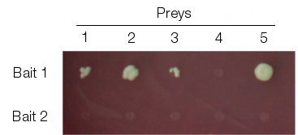
“Classical” Protein-protein interaction detection methods
X-ray diffraction studies
Low-throughput
Yeast-two hybrid (Y2H)
Tandem affinity purification+ mass spectrometry (TAP-MS)
High-throughput
Notes:
MATa : bait containing
MATapha : Prey

Slide 22
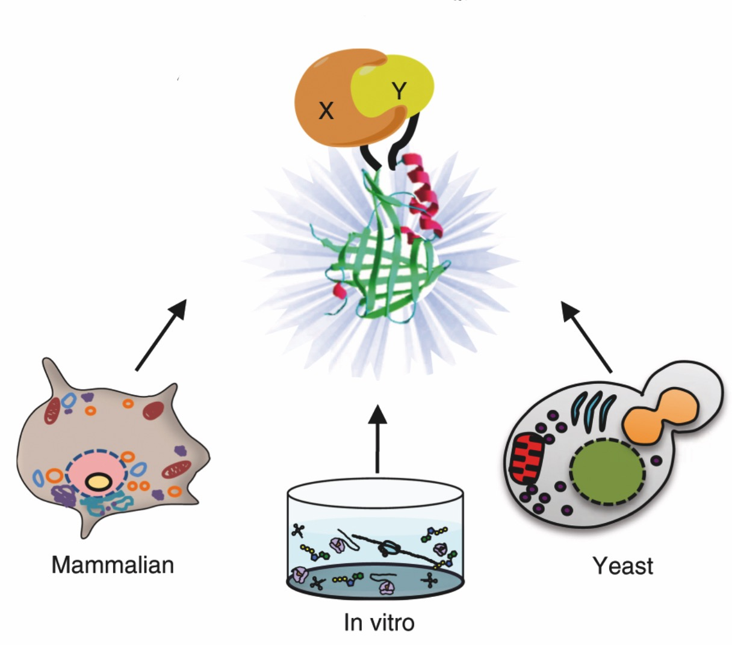
“Modern” Protein-protein High-throughput interaction detection methods
Protein complementation assays
GFP
Luciferase

Slide 23
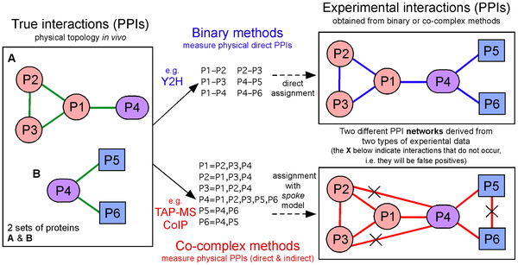
High-Throughput Protein-protein interaction detection methods

Slide 24
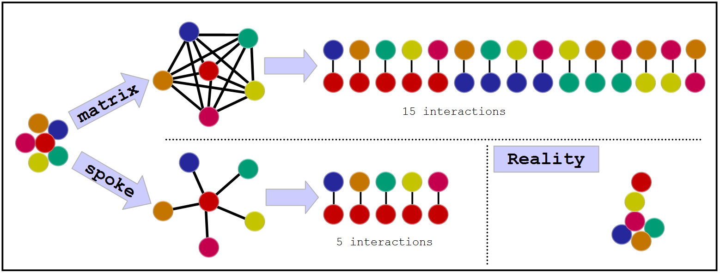
The problem with complexes
Some experimental methods generate complex data: E. g. Tag affinity purification (TAP)
There are two algorithms to transform this information into binary data:

Slide 25
Protein-protein interaction detection methods
No single method can accurately reproduce a true binary interaction observed under physiological conditions – every interaction detected experimentally is fundamentally artefactual.

Slide 26
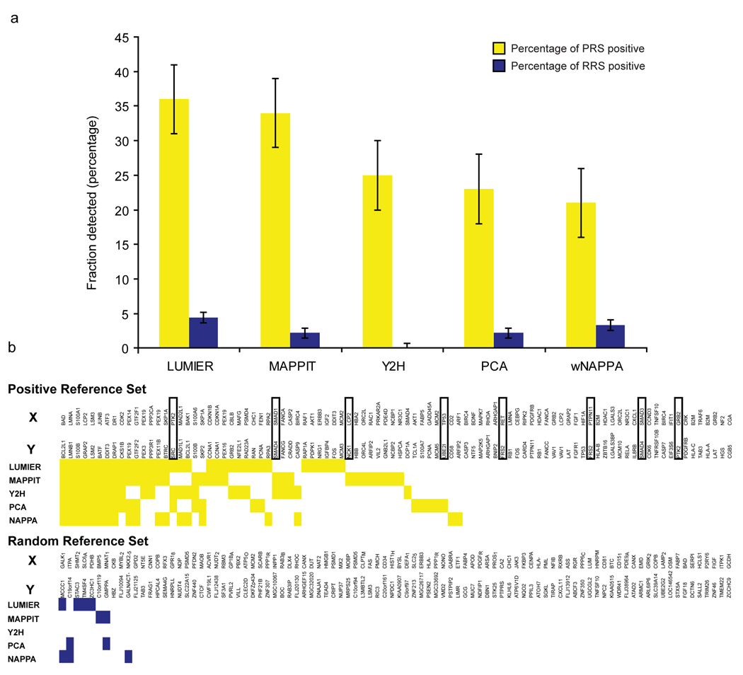
Protein-protein interaction detection methods
Braun et al., Nat Methods, 2008, PMID: 19060903.

Slide 27
Protein-protein interaction Network
N
N+1
N+1 Restricted

Slide 28
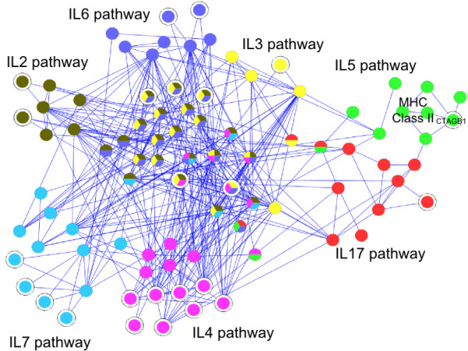
Characterization of protein complexes and pathways
Pathway Clustering
David (https://david.ncifcrf.gov)

Slide 29
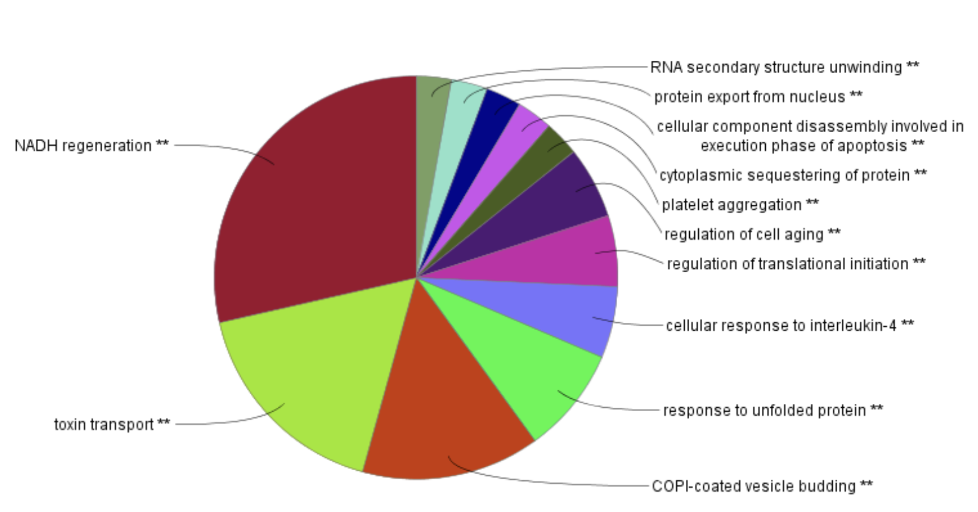
Protein-protein interaction detection methods
Gene Ontology (Function, structure, pathway, localization, …)
David (https://david.ncifcrf.gov)

Slide 30
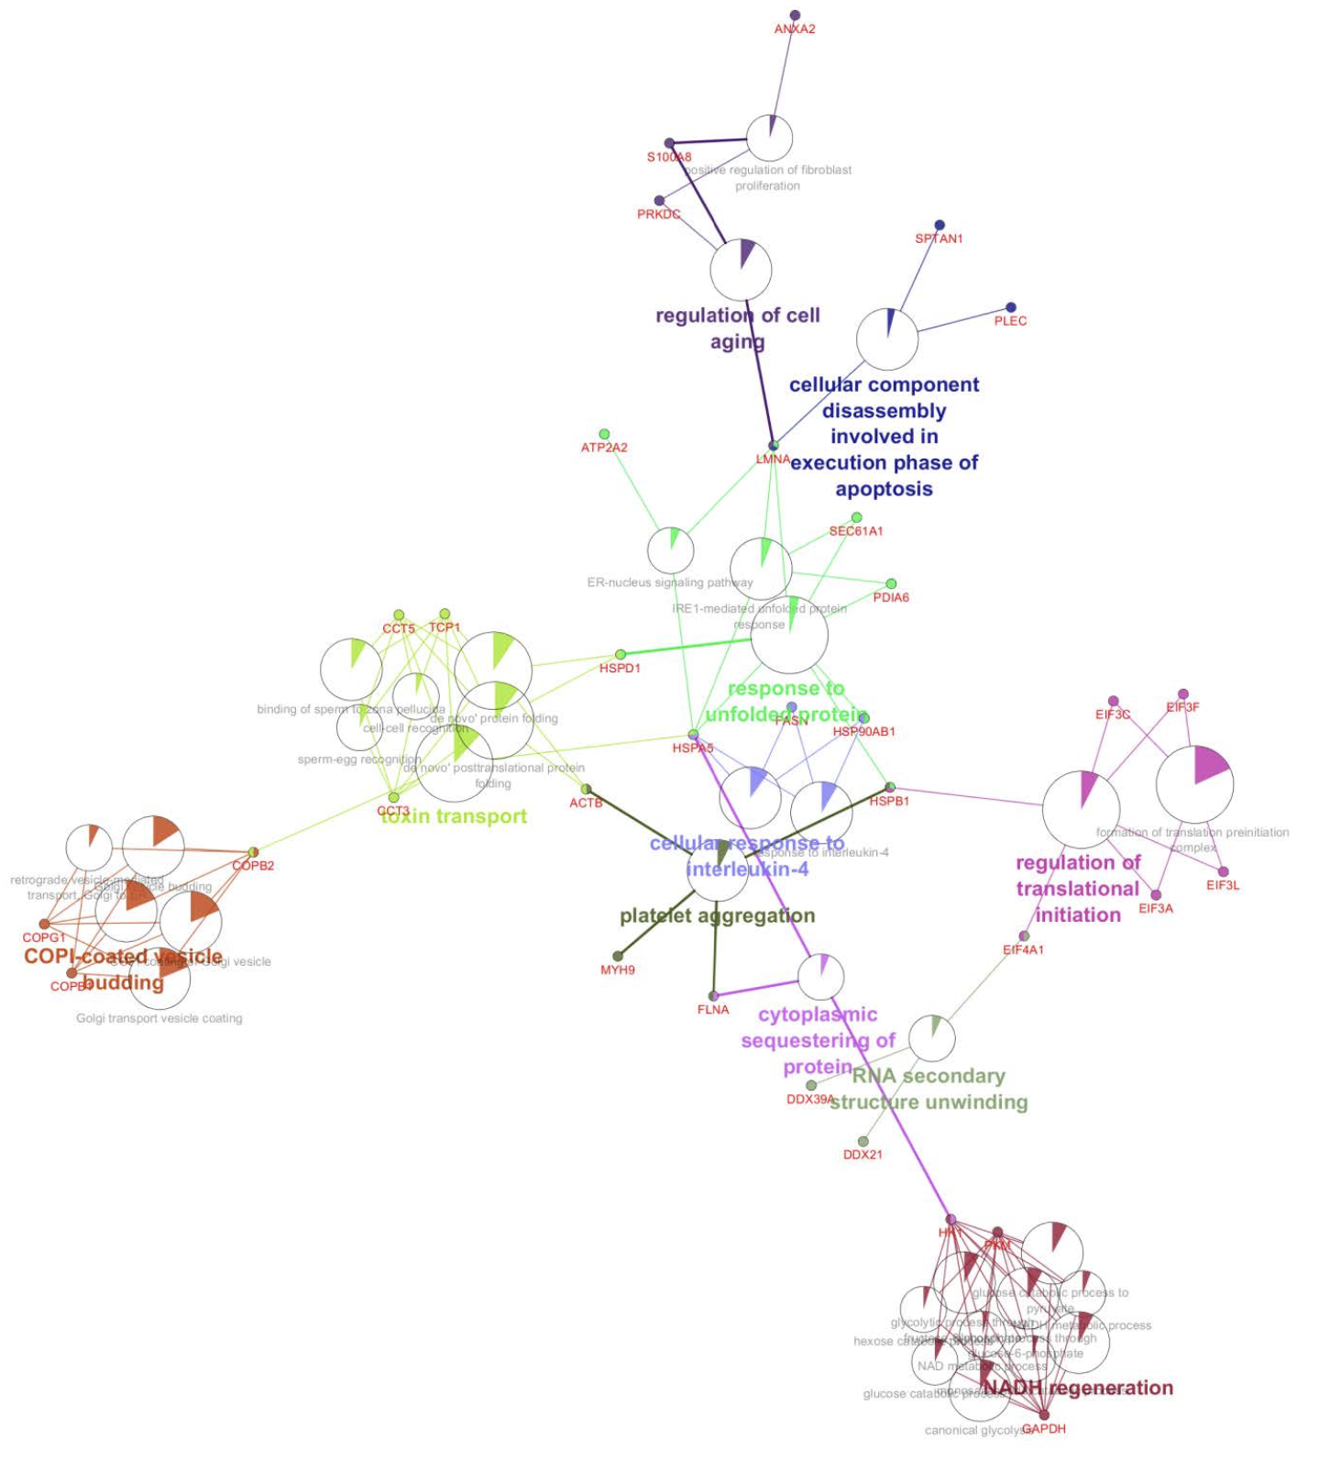
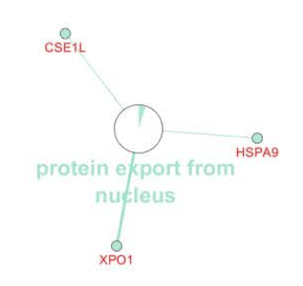
Protein-protein interaction detection methods
Gene Ontology (Function, structure, pathway, localization, …)
ClueGo: https://pubmed.ncbi.nlm.nih.gov/19237447/

Slide 31
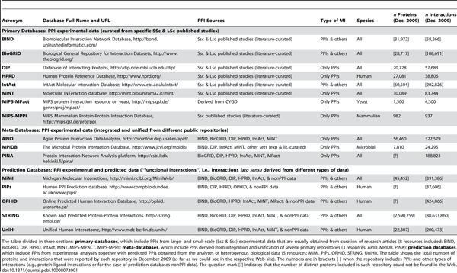
PPI databases and repositories

Slide 32
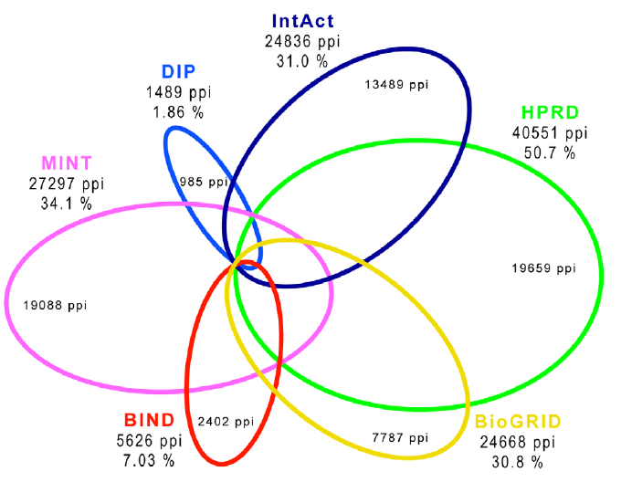
PPI databases: coverage
Human PPIs coverage in the main public primary databases
(Dec 2009)
some of the experimentally determined PPIs included in the databases are most probably false positives?→ increase PPI reliability with 3D data?

Slide 33
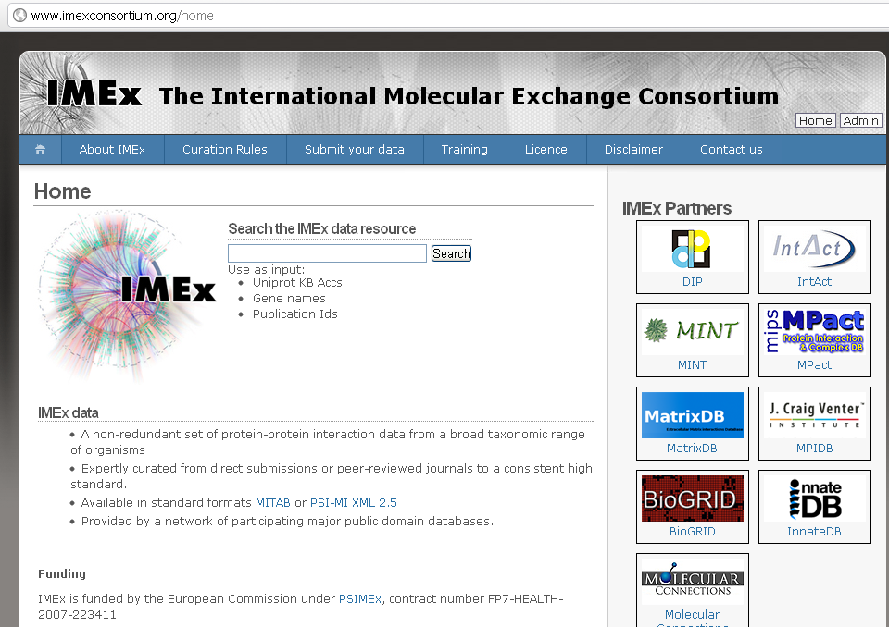
An attempt for increased PPIs reliability:
the IMEx consortium
www.imexconsortium.org
Orchard et al., Nature Methods, PMID: 22453911.

Slide 34
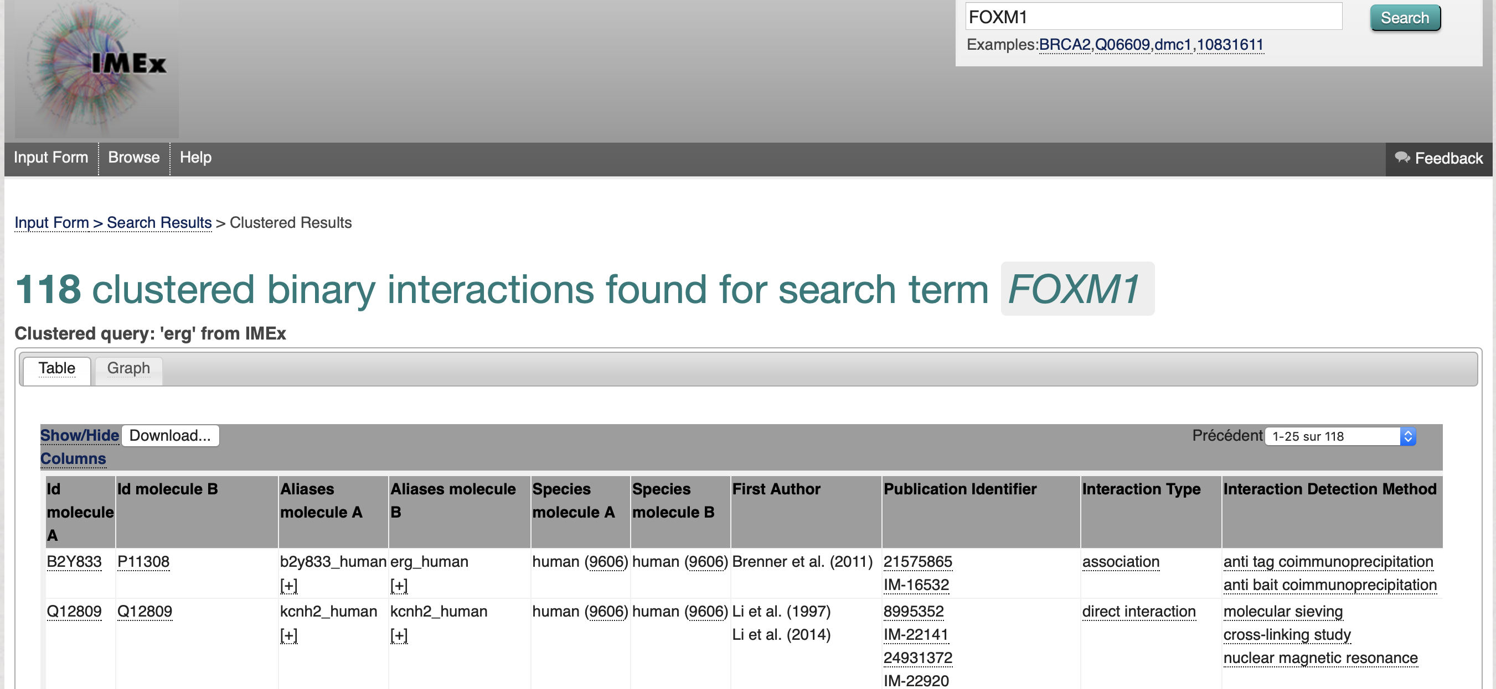

Slide 35
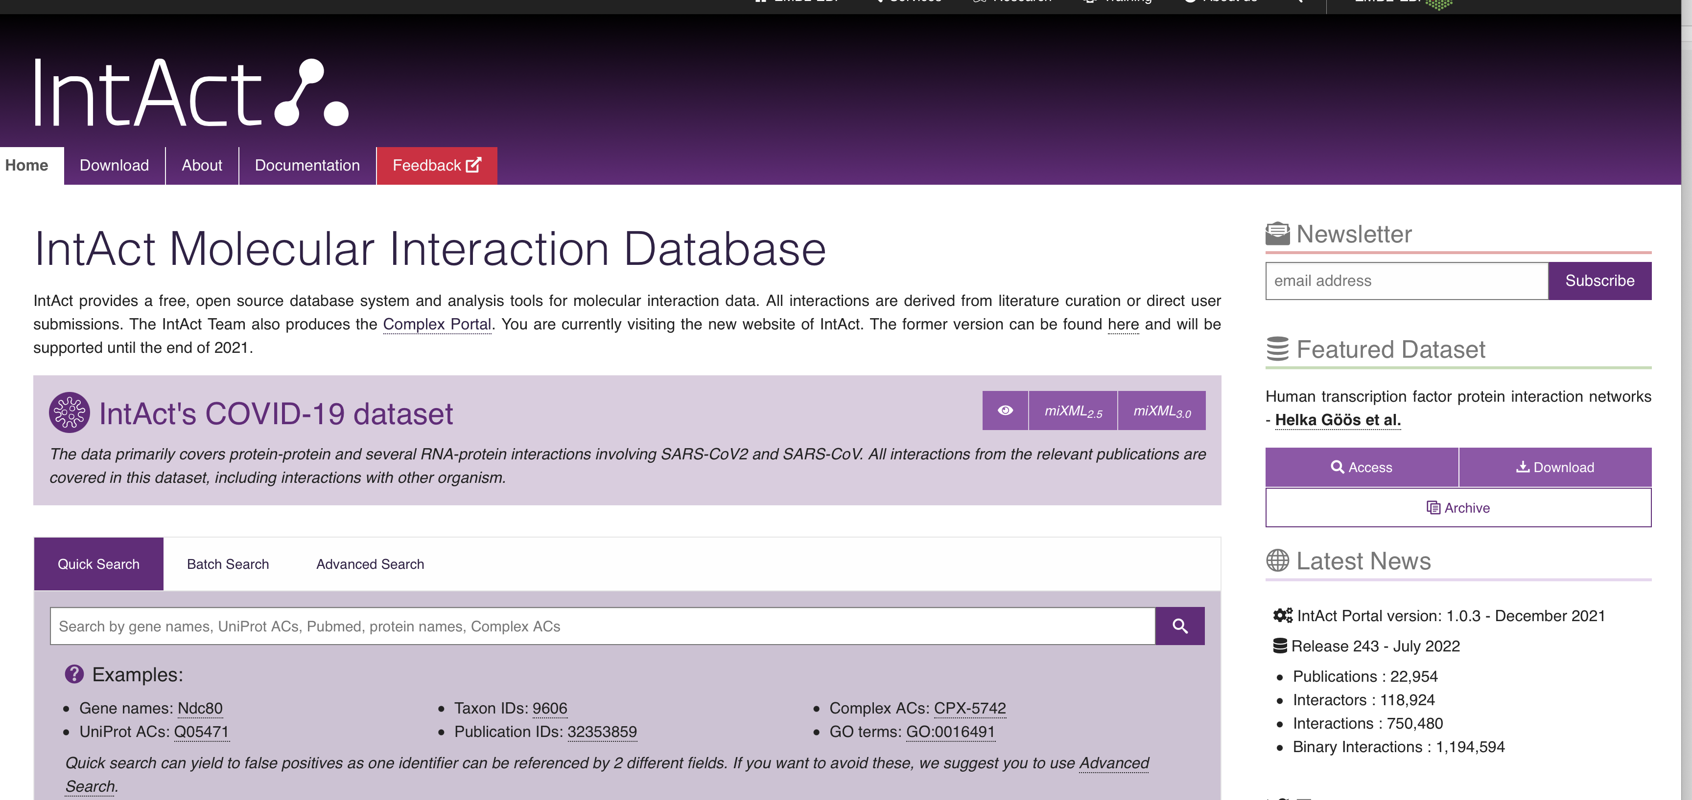
https://www.ebi.ac.uk/intact/

